Slide 1
CS 522: Machine Learning
Lecture 4 – Linear Regression

Slide 2
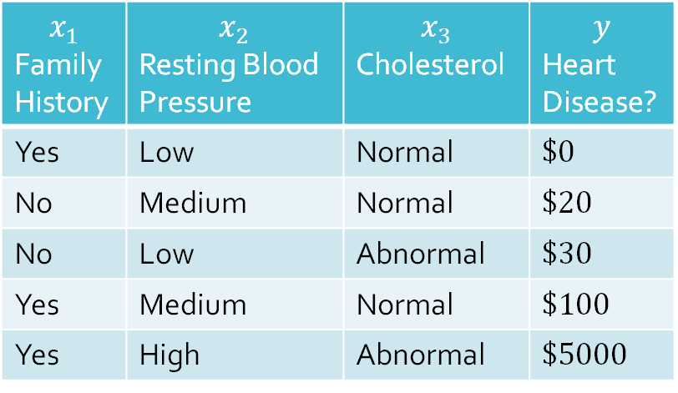
Recall:
Regression
Learning to diagnose heart disease
as a (supervised) binary regression task
features
targets
$$x_{1}$$ Family History | $$x_{2}$$ Resting Blood Pressure | $$x_{3}$$ Cholesterol | $$y$$ Heart Disease?
Yes | Low | Normal | $$\$0$$
No | Medium | Normal | $$\$20$$
No | Low | Abnormal | $$\$30$$
Yes | Medium | Normal | $$\$100$$
Yes | High | Abnormal | $$\$5000$$
data points

Slide 3
Decision Tree
Regression
Learning to diagnose heart disease
as a (supervised) binary regression task
features
targets
$$x_{1}$$ Family History | $$x_{2}$$ Resting Blood Pressure | $$x_{3}$$ Cholesterol | $$y$$ Heart Disease?
Yes | Low | Normal | $$\$0$$
No | Medium | Normal | $$\$20$$
No | Low | Abnormal | $$\$30$$
Yes | Medium | Normal | $$\$100$$
Yes | High | Abnormal | $$\$5000$$
data points

Slide 4




$1$-NN
Regression
Suppose we have real-valued targets $y∈ℝ$and one-dimensional inputs $x∈ℝ$
Assume
$$y=w^{T}x+w_{0}$$
Notation: given training data $𝒟={\left\{\left(x^{\left(i\right)},y^{\left(i\right)}\right)\right\}}_{i=1}^{N}$
  $X=\left[\begin{matrix}1 & {x^{\left(1\right)}}^{T} \\ 1 & {x^{\left(2\right)}}^{T} \\ ⋮ & ⋮ \\ 1 & {x^{\left(N\right)}}^{T}\end{matrix}\right]=\left[\begin{matrix}1 & x_{1}^{\left(1\right)} & ⋯ & x_{D}^{\left(1\right)} \\ 1 & x_{1}^{\left(2\right)} & ⋯ & x_{D}^{\left(2\right)} \\ ⋮ & ⋮ & ⋱ & ⋮ \\ 1 & x_{1}^{\left(N\right)} & ⋯ & x_{D}^{\left(N\right)}\end{matrix}\right]∈$ $ℝ^{N×D+1}$ is the design matrix
  $y={\left[y^{\left(1\right)},…,y^{\left(N\right)}\right]}^{T}∈ℝ^{N}$ is the target vector
$$y$$
$$x$$

Slide 5

Linear
Regression
Suppose we have real-valued targets $y∈ℝ$and $D$-dimensional inputs $x={\left[1,x_{1},…,x_{D}\right]}^{T}∈ℝ^{D}$
Assume
$$y=w^{T}x+w_{0}$$
Notation: given training data $𝒟={\left\{\left(x^{\left(i\right)},y^{\left(i\right)}\right)\right\}}_{i=1}^{N}$
  $X=\left[\begin{matrix}1 & {x^{\left(1\right)}}^{T} \\ 1 & {x^{\left(2\right)}}^{T} \\ ⋮ & ⋮ \\ 1 & {x^{\left(N\right)}}^{T}\end{matrix}\right]=\left[\begin{matrix}1 & x_{1}^{\left(1\right)} & ⋯ & x_{D}^{\left(1\right)} \\ 1 & x_{1}^{\left(2\right)} & ⋯ & x_{D}^{\left(2\right)} \\ ⋮ & ⋮ & ⋱ & ⋮ \\ 1 & x_{1}^{\left(N\right)} & ⋯ & x_{D}^{\left(N\right)}\end{matrix}\right]∈$ $ℝ^{N×D+1}$ is the design matrix
  $y={\left[y^{\left(1\right)},…,y^{\left(N\right)}\right]}^{T}∈ℝ^{N}$ is the target vector

Slide 6
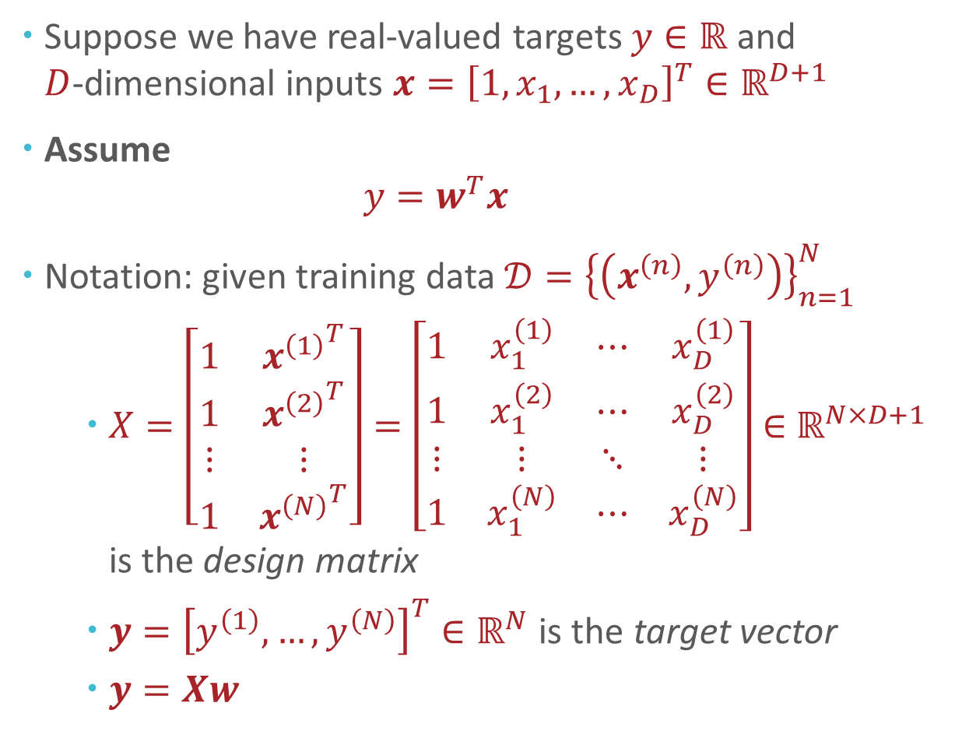
Linear
Regression
Suppose we have real-valued targets $y∈ℝ$and $D$-dimensional inputs $x={\left[1,x_{1},…,x_{D}\right]}^{T}∈ℝ^{D+1}$
Assume
$$y=w^{T}x+w_{0}$$
Notation: given training data $𝒟={\left\{\left(x^{\left(n\right)},y^{\left(n\right)}\right)\right\}}_{n=1}^{N}$
  $X=\left[\begin{matrix}1 & {x^{\left(1\right)}}^{T} \\ 1 & {x^{\left(2\right)}}^{T} \\ ⋮ & ⋮ \\ 1 & {x^{\left(N\right)}}^{T}\end{matrix}\right]=\left[\begin{matrix}1 & x_{1}^{\left(1\right)} & ⋯ & x_{D}^{\left(1\right)} \\ 1 & x_{1}^{\left(2\right)} & ⋯ & x_{D}^{\left(2\right)} \\ ⋮ & ⋮ & ⋱ & ⋮ \\ 1 & x_{1}^{\left(N\right)} & ⋯ & x_{D}^{\left(N\right)}\end{matrix}\right]∈$ $ℝ^{N×D+1}$ is the design matrix
  $y={\left[y^{\left(1\right)},…,y^{\left(N\right)}\right]}^{T}∈ℝ^{N}$ is the target vector
  $y=Xw$

Slide 7

General
Recipe for
Machine Learning
Define a model and model parameters
  Assume $y=w^{T}x$
  Parameters: $w=\left[w_{0},w_{1},…,w_{D}\right]$
Write down an objective function
  Minimize the squared error
Optimize the objective w.r.t. the model parameters
  Solve in closed form: take partial derivatives,
  set to 0 and solve

Slide 8
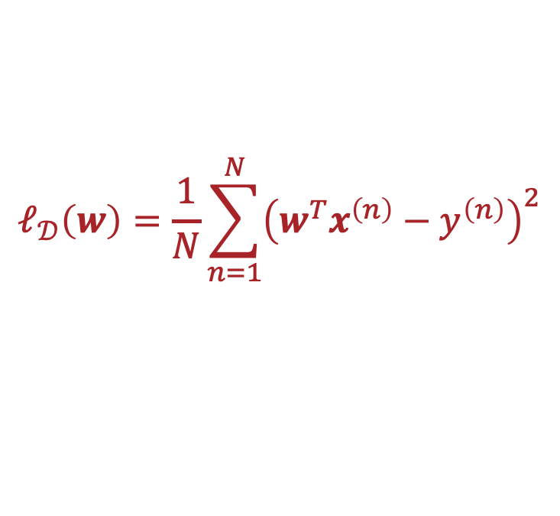
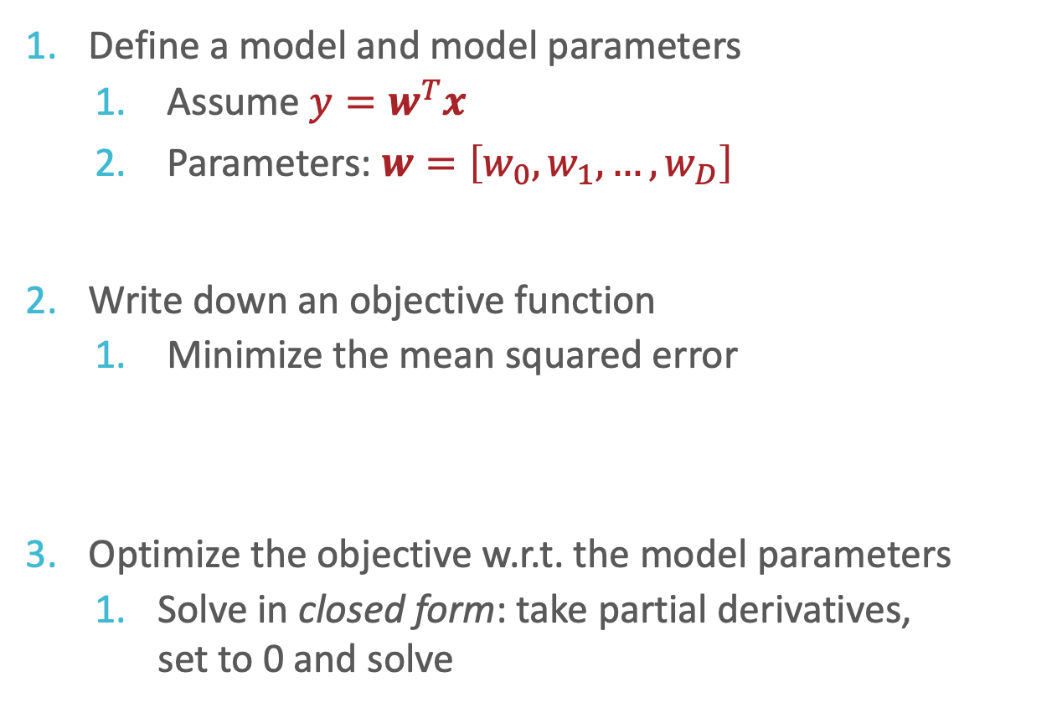
Recipe for
Linear
Regression
Define a model and model parameters
  Assume $y=w^{T}x$
  Parameters: $w=\left[w_{0},w_{1},…,w_{D}\right]$
Write down an objective function
  Minimize the mean squared error
Optimize the objective w.r.t. the model parameters
  Solve in closed form: take partial derivatives,
  set to 0 and solve
$$ℓ_{𝒟}\left(w\right)=\frac{1}{N}\sum_{n=1}^{N}{{\left(w^{T}x^{\left(n\right)}−y^{\left(n\right)}\right)}^{2}}$$

Slide 9

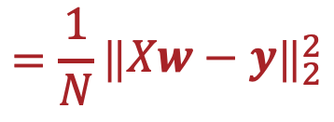

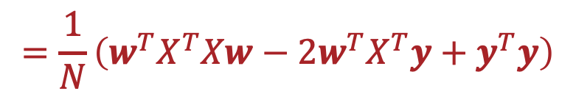
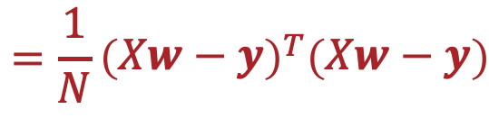
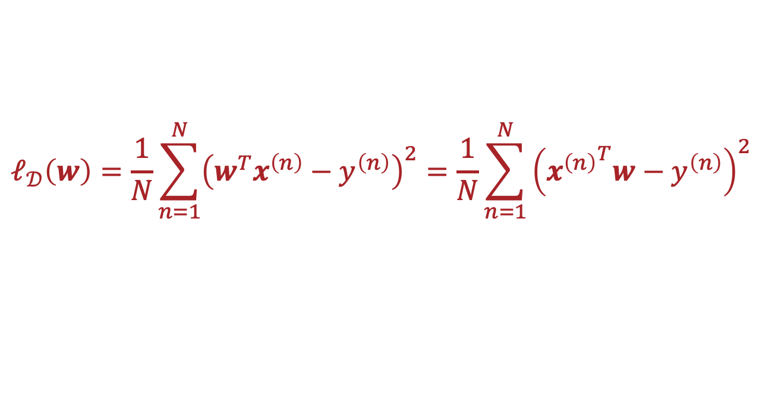
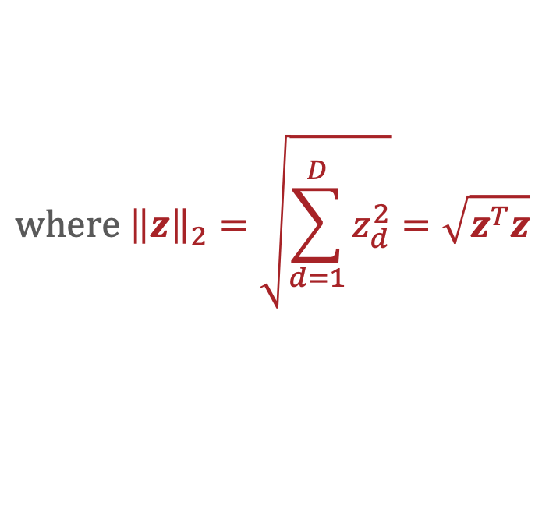
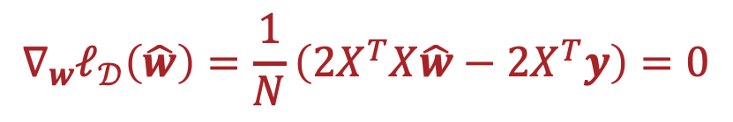
Minimizing the Squared Error
$$ℓ_{𝒟}\left(w\right)=\frac{1}{N}\sum_{n=1}^{N}{{\left(w^{T}x^{\left(n\right)}−y^{\left(n\right)}\right)}^{2}}=\frac{1}{N}\sum_{n=1}^{N}{{\left({x^{\left(n\right)}}^{T}w−y^{\left(n\right)}\right)}^{2}}$$
$$where {\left\|z\right\|}_{2}=\sqrt{\sum_{d=1}^{D}{z_{d}^{2}}}=\sqrt{z^{T}z}$$
$$={\frac{1}{N}\left\|\begin{matrix}Xw−y\end{matrix}\right\|}_{2}^{2}$$
$$=\frac{1}{N}{\left(\begin{matrix}Xw−y\end{matrix}\right)}^{T}\left(\begin{matrix}Xw−y\end{matrix}\right)$$
$$=\frac{1}{N}\left(w^{T}X^{T}Xw−2w^{T}X^{T}y+y^{T}y\right)$$
$$∇_{w}ℓ_{𝒟}\left(\hat{w}\right)=\frac{1}{N}\left(2X^{T}X\hat{w}−2X^{T}y\right)=0$$
$$→X^{T}X\hat{w}=X^{T}y$$
$$→\hat{w}={\left(X^{T}X\right)}^{−1}X^{T}y$$

Slide 10


Minimizing the Squared Error
$$ℓ_{𝒟}\left(w\right)=\frac{1}{N}\sum_{n=1}^{N}{{\left(w^{T}x^{\left(n\right)}−y^{\left(n\right)}\right)}^{2}}=\frac{1}{N}\sum_{n=1}^{N}{{\left({x^{\left(n\right)}}^{T}w−y^{\left(n\right)}\right)}^{2}}$$
$$where {\left\|z\right\|}_{2}=\sqrt{\sum_{d=1}^{D}{z_{d}^{2}}}=\sqrt{z^{T}z}$$
$$={\frac{1}{N}\left\|\begin{matrix}Xw−y\end{matrix}\right\|}_{2}^{2}$$
$$=\frac{1}{N}{\left(\begin{matrix}Xw−y\end{matrix}\right)}^{T}\left(\begin{matrix}Xw−y\end{matrix}\right)$$
$$=\frac{1}{N}\left(w^{T}X^{T}Xw−2w^{T}X^{T}y+y^{T}y\right)$$
$$∇_{w}ℓ_{𝒟}\left(\hat{w}\right)=\frac{1}{N}\left(2X^{T}X\hat{w}−2X^{T}y\right)=0$$
$$H_{w}ℓ_{𝒟}\left(w\right)=\frac{2}{N}X^{T}X$$
$→H_{w}ℓ_{𝒟}\left(w\right)$ is positive semi-definite

Slide 11


Closed Form Solution
$$\hat{w}={\left(X^{T}X\right)}^{−1}X^{T}y$$
Is $X^{T}X$ invertible?
  When $N≫D+1$, $X^{T}X$is (almost always) full rank and therefore, invertible!
  If $X^{T}X$is not invertible (occurs when one of the features is a linear combination of the others) then there are infinitely many solutions.
If so, how computationally expensive is inverting $X^{T}X$?
  $X^{T}X∈ℝ^{D+1×D+1}$ so inverting $X^{T}X$takes $O\left(D^{3}\right)$ time…
    Computing $X^{T}X$ takes $O\left(ND^{2}\right)$ time
  Can use gradient descent to (potentially) speed things up when $N$ and $D$ are large!

Slide 12

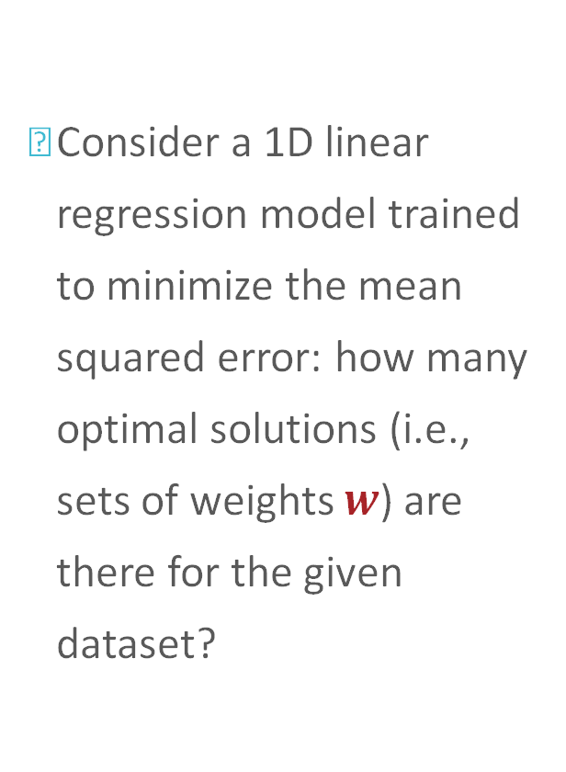

Linear Regression: Uniqueness
Consider a 1D linear regression model trained to minimize the mean squared error: how many optimal solutions (i.e., sets of weights $w$) are there for the given dataset?
$$y$$
$$x$$

Slide 13
Linear Regression: Uniqueness
Consider a 1D linear regression model trained to minimize the mean squared error: how many optimal solutions (i.e., sets of weights $w$) are there for the given dataset?
$$y$$
$$x$$
Notes:
You can infinitely many points passing trough the point.

Slide 14
Linear Regression: Uniqueness
Consider a 1D linear regression model trained to minimize the mean squared error: how many optimal solutions (i.e., sets of weights $w$) are there for the given dataset?
$$y$$
$$x$$
Notes:
You have infinitely many lines that pass through the mid-point of two points on the y-axis.

Slide 15
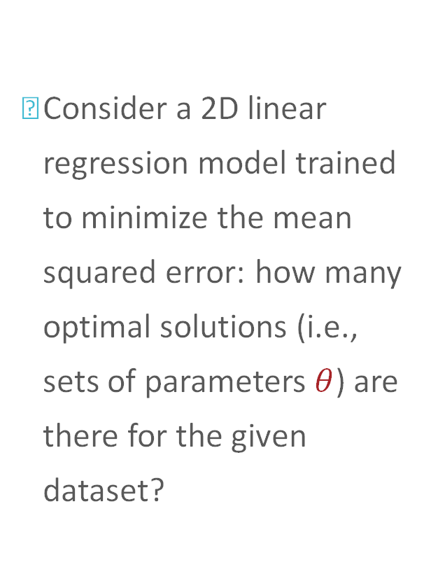



Linear Regression: Uniqueness
Consider a 2D linear regression model trained to minimize the mean squared error: how many optimal solutions (i.e., sets of parameters $θ$) are there for the given dataset?
$$y$$
$$x1$$
$$x2$$

Slide 16
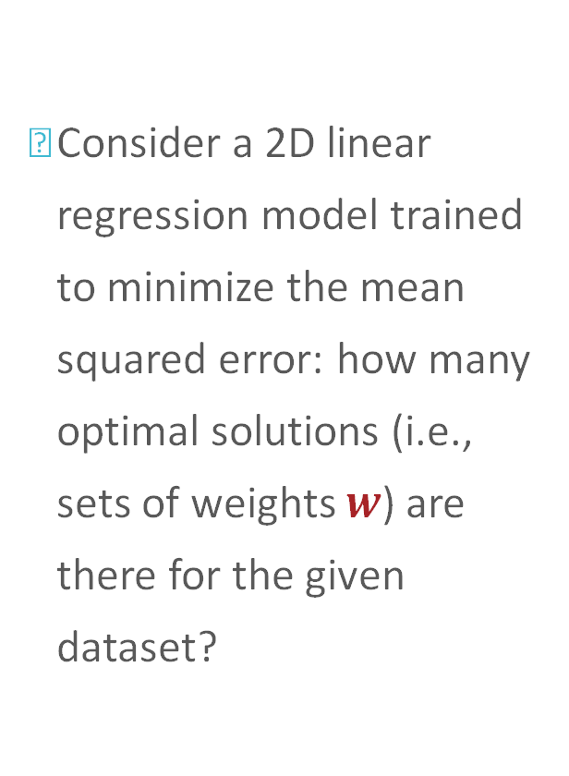
Linear Regression: Uniqueness
Consider a 2D linear regression model trained to minimize the mean squared error: how many optimal solutions (i.e., sets of weights $w$) are there for the given dataset?
$$y$$
$$x1$$
$$x2$$

Slide 17
Linear Regression: Uniqueness
Consider a 2D linear regression model trained to minimize the mean squared error: how many optimal solutions (i.e., sets of weights $w$) are there for the given dataset?
$$y$$
$$x1$$
$$x2$$

Slide 18
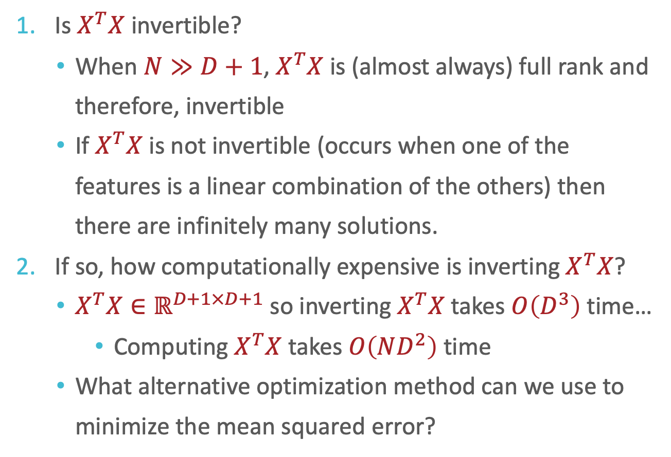

Closed Form Solution
$$\hat{w}={\left(X^{T}X\right)}^{−1}X^{T}y$$
Is $X^{T}X$ invertible?
  When $N≫D+1$, $X^{T}X$is (almost always) full rank and therefore, invertible
  If $X^{T}X$is not invertible (occurs when one of the features is a linear combination of the others) then there are infinitely many solutions.
If so, how computationally expensive is inverting $X^{T}X$?
  $X^{T}X∈ℝ^{D+1×D+1}$ so inverting $X^{T}X$takes $O\left(D^{3}\right)$ time…
    Computing $X^{T}X$ takes $O\left(ND^{2}\right)$ time
  What alternative optimization method can we use to minimize the mean squared error?

Slide 19
Gradient Descent:
Intuition
An iterative method for minimizing functions
Requires the gradient to exist everywhere

Slide 20
Gradient Descent:
Intuition
An iterative method for minimizing functions
Requires the gradient to exist everywhere

Slide 21
Gradient Descent:
Intuition
An iterative method for minimizing functions
Requires the gradient to exist everywhere

Slide 22
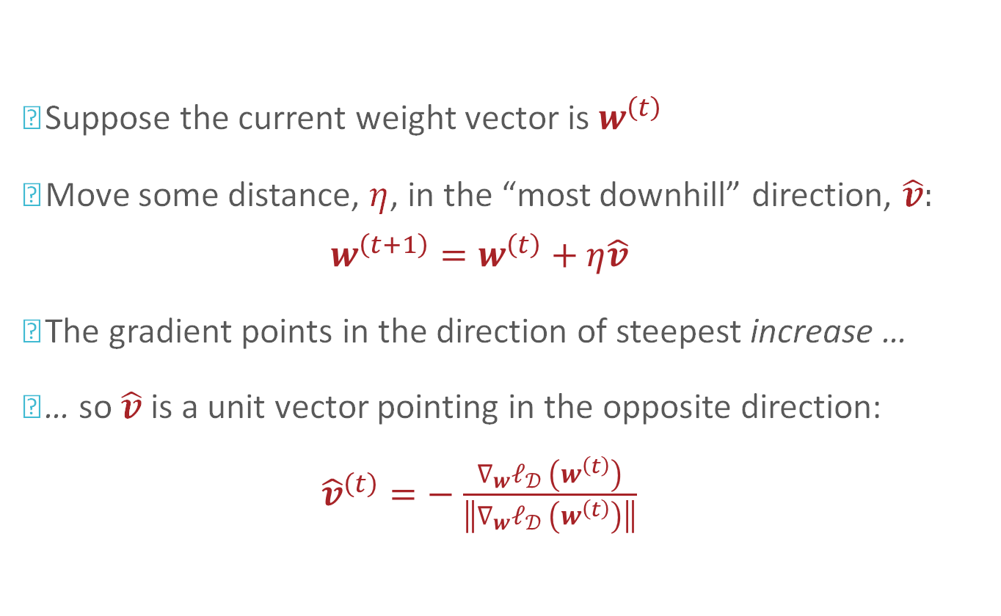
Gradient Descent
Suppose the current weight vector is $w^{\left(t\right)}$
Move some distance, $η$, in the “most downhill” direction, $\hat{v}$:
$$w^{\left(t+1\right)}=w^{\left(t\right)}+η\hat{v}$$
The gradient points in the direction of steepest increase …
… so $\hat{v}$ is a unit vector pointing in the opposite direction:
${\hat{v}}^{\left(t\right)}=−$ $\frac{∇_{w}ℓ_{𝒟 }\left(w^{\left(t\right)}\right)}{\left\|\begin{matrix}∇_{w}ℓ_{𝒟 }\left(w^{\left(t\right)}\right)\end{matrix}\right\|}$
Notes:
Can also show this using a Taylor series expansion

Slide 23
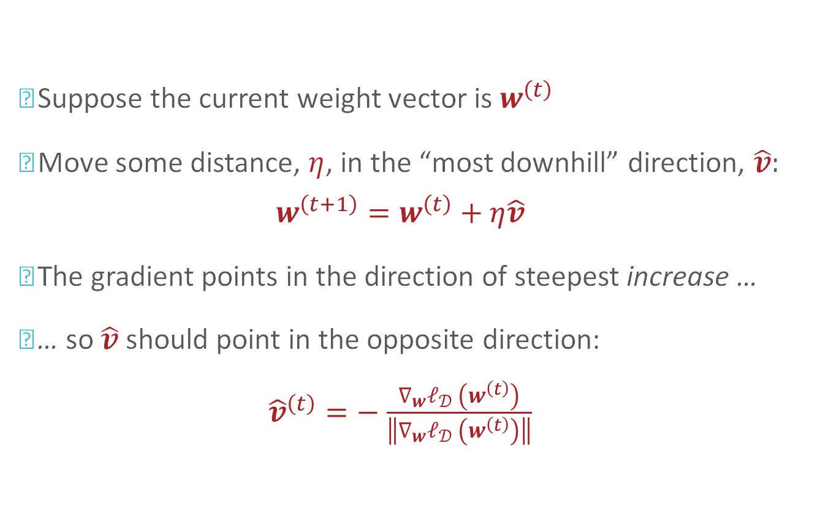
Gradient Descent:
Step Direction
Suppose the current weight vector is $w^{\left(t\right)}$
Move some distance, $η$, in the “most downhill” direction, $\hat{v}$:
$$w^{\left(t+1\right)}=w^{\left(t\right)}+η\hat{v}$$
The gradient points in the direction of steepest increase …
… so $\hat{v}$ should point in the opposite direction:
${\hat{v}}^{\left(t\right)}=−$ $\frac{∇_{w}ℓ_{𝒟 }\left(w^{\left(t\right)}\right)}{\left\|\begin{matrix}∇_{w}ℓ_{𝒟 }\left(w^{\left(t\right)}\right)\end{matrix}\right\|}$
Notes:
Can also show this using a Taylor series expansion

Slide 24


Gradient Descent:
Step Size
Small $η$
Large $η$

Slide 25
Gradient Descent:
Step Size
Small $η$
Large $η$

Slide 26
Gradient Descent:
Step Size
Small $η$
Large $η$

Slide 27
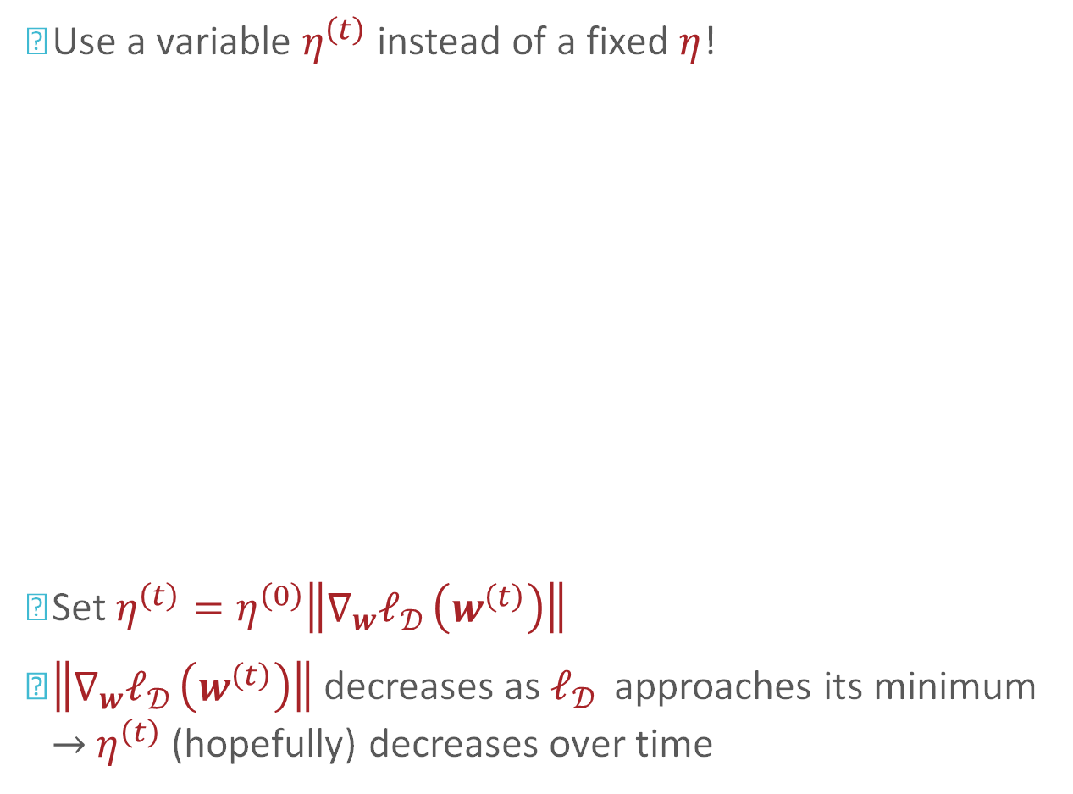
Gradient Descent:
Step Size
Use a variable $η^{\left(t\right)}$ instead of a fixed $η$!
Set $η^{\left(t\right)}=η^{\left(0\right)}\left\|\begin{matrix}∇_{w}ℓ_{𝒟 }\left(w^{\left(t\right)}\right)\end{matrix}\right\|$
$\left\|\begin{matrix}∇_{w}ℓ_{𝒟 }\left(w^{\left(t\right)}\right)\end{matrix}\right\|$decreases as $ℓ_{𝒟 }$ approaches its minimum $→$ $η^{\left(t\right)}$ (hopefully) decreases over time

Slide 28
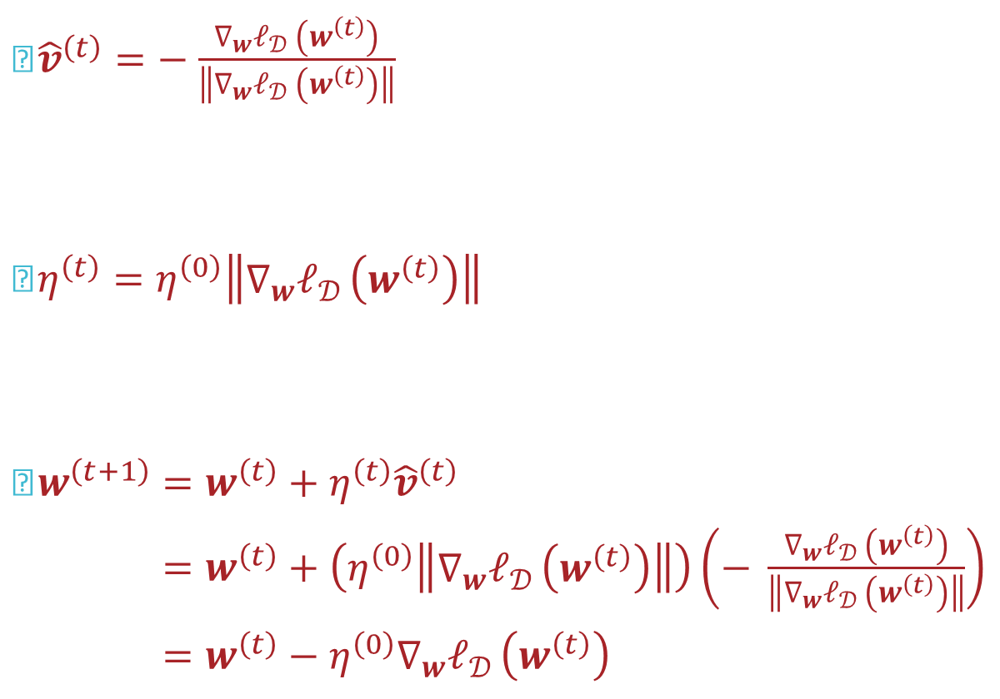
Gradient Descent
${\hat{v}}^{\left(t\right)}=−$ $\frac{∇_{w}ℓ_{𝒟 }\left(w^{\left(t\right)}\right)}{\left\|\begin{matrix}∇_{w}ℓ_{𝒟 }\left(w^{\left(t\right)}\right)\end{matrix}\right\|}$
$η^{\left(t\right)}=η^{\left(0\right)}\left\|\begin{matrix}∇_{w}ℓ_{𝒟 }\left(w^{\left(t\right)}\right)\end{matrix}\right\|$
$w^{\left(t+1\right)}=w^{\left(t\right)}+η^{\left(t\right)}{\hat{v}}^{\left(t\right)}$
$w^{\left(t+1\right)}=w^{\left(t\right)}+\left(η^{\left(0\right)}\left\|\begin{matrix}∇_{w}ℓ_{𝒟 }\left(w^{\left(t\right)}\right)\end{matrix}\right\|\right)\left(− \frac{∇_{w}ℓ_{𝒟 }\left(w^{\left(t\right)}\right)}{\left\|\begin{matrix}∇_{w}ℓ_{𝒟 }\left(w^{\left(t\right)}\right)\end{matrix}\right\|}\right)$
$w^{\left(t+1\right)}=w^{\left(t\right)}−η^{\left(0\right)}∇_{w}ℓ_{𝒟 }\left(w^{\left(t\right)}\right)$

Slide 29
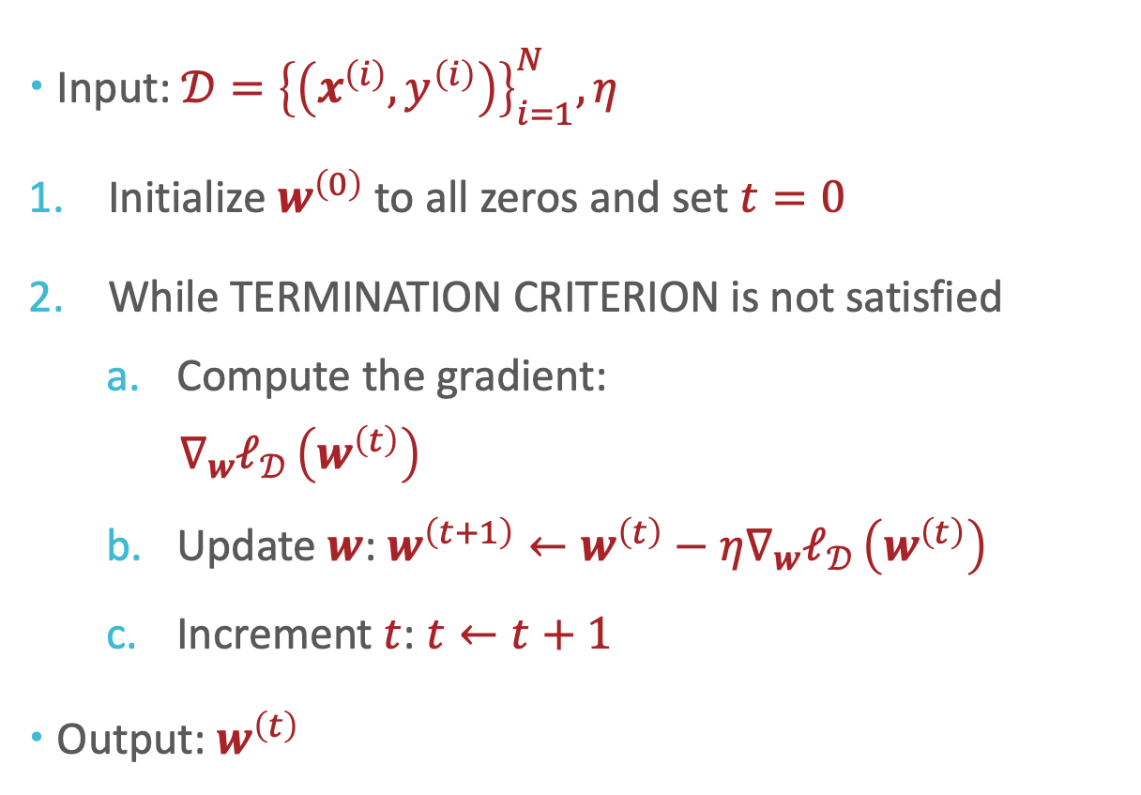
Gradient Descent
Input: $𝒟={\left\{\left(x^{\left(i\right)},y^{\left(i\right)}\right)\right\}}_{i=1}^{N},η$
Initialize $w^{\left(0\right)}$ to all zeros and set $t=0$
While TERMINATION CRITERION is not satisfied
  Compute the gradient:
  $$∇_{w}ℓ_{𝒟 }\left(w^{\left(t\right)}\right)=\left(2X^{T}Xw−2X^{T}y\right)$$
  Update $w$: $w^{\left(t+1\right)}←w^{\left(t\right)}−η∇_{w}ℓ_{𝒟 }\left(w^{\left(t\right)}\right)$
  Increment $t$: $t←t+1$
Output: $w^{\left(t\right)}$

Slide 30
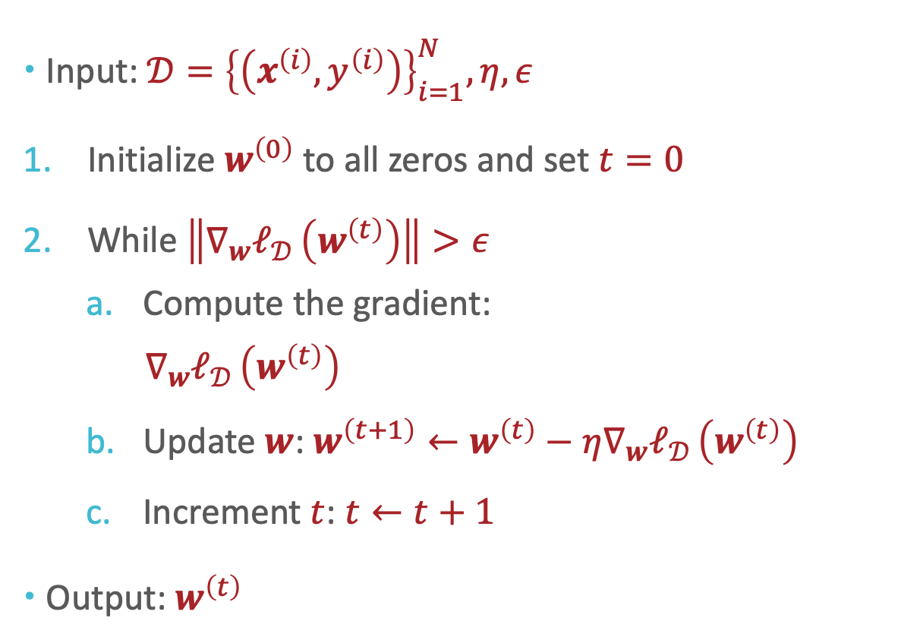
Gradient Descent
Input: $𝒟={\left\{\left(x^{\left(i\right)},y^{\left(i\right)}\right)\right\}}_{i=1}^{N},η,ε$
Initialize $w^{\left(0\right)}$ to all zeros and set $t=0$
While $\left\|\begin{matrix}∇_{w}ℓ_{𝒟 }\left(w^{\left(t\right)}\right)\end{matrix}\right\|>ε$
  Compute the gradient:
  $$∇_{w}ℓ_{𝒟 }\left(w^{\left(t\right)}\right)=\left(2X^{T}Xw−2X^{T}y\right)$$
  Update $w$: $w^{\left(t+1\right)}←w^{\left(t\right)}−η∇_{w}ℓ_{𝒟 }\left(w^{\left(t\right)}\right)$
  Increment $t$: $t←t+1$
Output: $w^{\left(t\right)}$

Slide 31
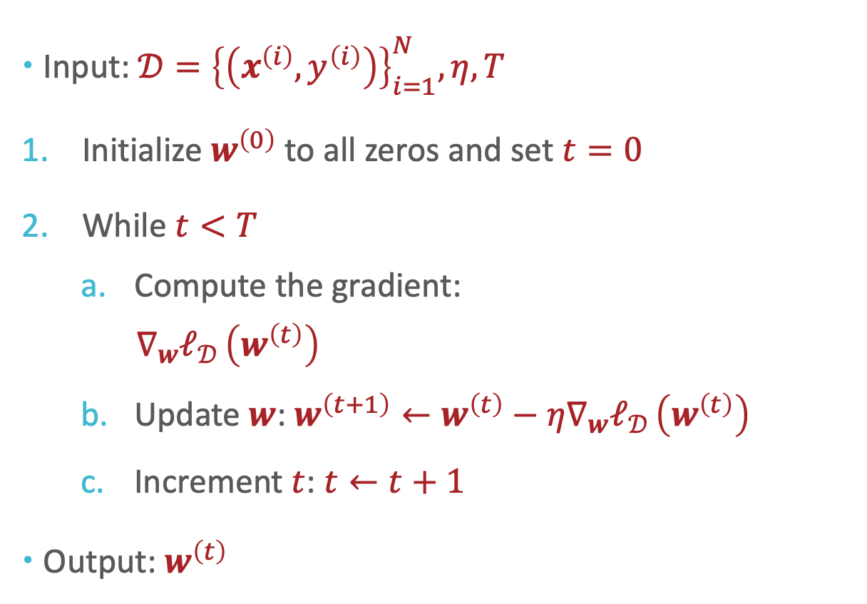
Gradient Descent
Input: $𝒟={\left\{\left(x^{\left(i\right)},y^{\left(i\right)}\right)\right\}}_{i=1}^{N},η,T$
Initialize $w^{\left(0\right)}$ to all zeros and set $t=0$
While $t<T$
  Compute the gradient:
  $$∇_{w}ℓ_{𝒟 }\left(w^{\left(t\right)}\right)=\left(2X^{T}Xw−2X^{T}y\right)$$
  Update $w$: $w^{\left(t+1\right)}←w^{\left(t\right)}−η∇_{w}ℓ_{𝒟 }\left(w^{\left(t\right)}\right)$
  Increment $t$: $t←t+1$
Output: $w^{\left(t\right)}$

Slide 32
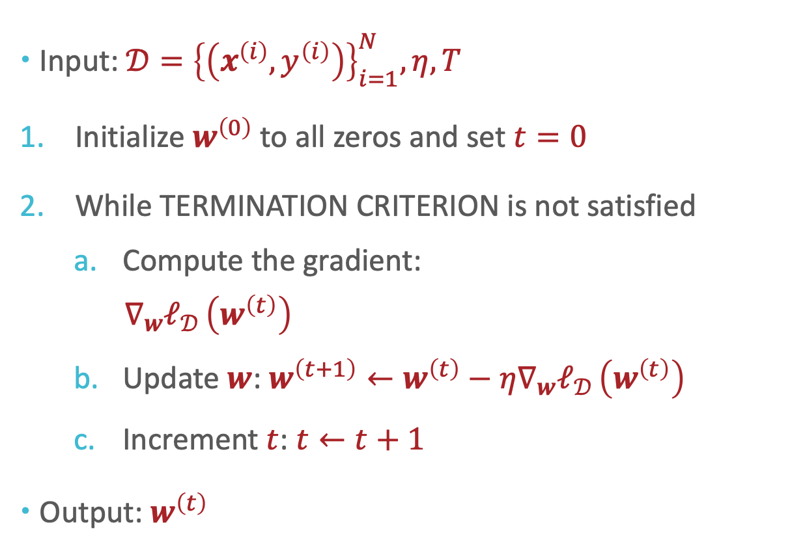
Why
Gradient Descent for linear regression?
Input: $𝒟={\left\{\left(x^{\left(i\right)},y^{\left(i\right)}\right)\right\}}_{i=1}^{N},η,T$
Initialize $w^{\left(0\right)}$ to all zeros and set $t=0$
While TERMINATION CRITERION is not satisfied
  Compute the gradient:
  $$∇_{w}ℓ_{𝒟 }\left(w^{\left(t\right)}\right)=\left(2X^{T}Xw−2X^{T}y\right)$$
  Update $w$: $w^{\left(t+1\right)}←w^{\left(t\right)}−η∇_{w}ℓ_{𝒟 }\left(w^{\left(t\right)}\right)$
  Increment $t$: $t←t+1$
Output: $w^{\left(t\right)}$

Slide 33







Convexity
A function $f:ℝ^{D}→ℝ$ is strictly convex if
$∀ x^{\left(1\right)}∈ℝ^{D},x^{\left(2\right)}∈ℝ^{D}$ and $0≤c≤1$
$$f\left(cx^{\left(1\right)}+\left(1−c\right)x^{\left(2\right)}\right)≤cf\left(x^{\left(1\right)}\right)+\left(1−c\right)f\left(x^{\left(2\right)}\right)$$
$$f$$
$$cf\left(x^{\left(1\right)}\right)+\left(1−c\right)f\left(x^{\left(2\right)}\right)$$
$$f\left(cx^{\left(1\right)}+\left(1−c\right)x^{\left(2\right)}\right)$$
$$x^{\left(1\right)}$$
$$cx^{\left(1\right)}+\left(1−c\right)x^{\left(2\right)}$$
$$x^{\left(2\right)}$$

Slide 34

Convexity
A function $f:ℝ^{D}→ℝ$ is strictly convex if
$∀ x^{\left(1\right)}∈ℝ^{D},x^{\left(2\right)}∈ℝ^{D}$ and $0≤c≤1$
$$f\left(cx^{\left(1\right)}+\left(1−c\right)x^{\left(2\right)}\right)≤cf\left(x^{\left(1\right)}\right)+\left(1−c\right)f\left(x^{\left(2\right)}\right)$$
$$f$$
$$cf\left(x^{\left(1\right)}\right)+\left(1−c\right)f\left(x^{\left(2\right)}\right)$$
$$f\left(cx^{\left(1\right)}+\left(1−c\right)x^{\left(2\right)}\right)$$
$$x^{\left(1\right)}$$
$$cx^{\left(1\right)}+\left(1−c\right)x^{\left(2\right)}$$
$$x^{\left(2\right)}$$

Slide 35

Convexity
A function $f:ℝ^{D}→ℝ$ is strictly convex if
$∀ x^{\left(1\right)}∈ℝ^{D},x^{\left(2\right)}∈ℝ^{D}$ and $0<c<1$
$$f\left(cx^{\left(1\right)}+\left(1−c\right)x^{\left(2\right)}\right)<cf\left(x^{\left(1\right)}\right)+\left(1−c\right)f\left(x^{\left(2\right)}\right)$$
$$f$$
$$cf\left(x^{\left(1\right)}\right)+\left(1−c\right)f\left(x^{\left(2\right)}\right)$$
$$f\left(cx^{\left(1\right)}+\left(1−c\right)x^{\left(2\right)}\right)$$
$$x^{\left(1\right)}$$
$$cx^{\left(1\right)}+\left(1−c\right)x^{\left(2\right)}$$
$$x^{\left(2\right)}$$

Slide 36
Convexity
Convex functions
Non-convex functions

Slide 37
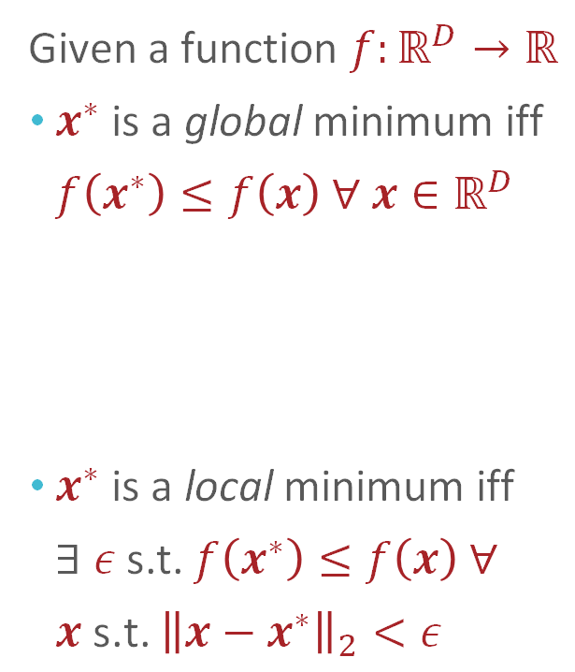
Convexity
Given a function $f:ℝ^{D}→ℝ$
$x^{∗}$ is a global minimum iff $f\left(x^{∗}\right)≤f\left(x\right) ∀ x∈ℝ^{D}$
$x^{∗}$ is a local minimum iff $∃ ε$ s.t. $f\left(x^{∗}\right)≤f\left(x\right) ∀$
$x \text{s}\text{.}\text{t}\text{.}$ ${\left\|x−x^{∗}\right\|}_{2}<ε$

Slide 38
Convexity
Convex functions:
Each local minimum is a global minimum!
Non-convex functions:
A local minimum may or may not be a global minimum…

Slide 39
Convexity
Strictly convex functions:
There exists a unique global minimum!
Non-convex functions:
A local minimum may or may not be a global minimum…

Slide 40
Gradient Descent & Convexity
Gradient descent is a local optimization algorithm – it will converge to a local minimum (if it converges)
  Works great if the objective function is convex!

Slide 41
Gradient Descent & Convexity
Gradient descent is a local optimization algorithm – it will converge to a local minimum (if it converges)
  Works great if the objective function is convex!

Slide 42
Gradient Descent & Convexity
Gradient descent is a local optimization algorithm – it will converge to a local minimum (if it converges)
  Works great if the objective function is convex!

Slide 43
Gradient Descent & Convexity
Gradient descent is a local optimization algorithm – it will converge to a local minimum (if it converges)
  Works great if the objective function is convex!

Slide 44
Gradient Descent & Convexity
Gradient descent is a local optimization algorithm – it will converge to a local minimum (if it converges)
  Not ideal if the objective function is non-convex…

Slide 45
Gradient Descent & Convexity
Gradient descent is a local optimization algorithm – it will converge to a local minimum (if it converges)
  Not ideal if the objective function is non-convex…

Slide 46
Gradient Descent & Convexity
Gradient descent is a local optimization algorithm – it will converge to a local minimum (if it converges)
  Not ideal if the objective function is non-convex…

Slide 47
Gradient Descent & Convexity
Gradient descent is a local optimization algorithm – it will converge to a local minimum (if it converges)
  Not ideal if the objective function is non-convex…

Slide 48

The squared error for linear regression is convex (but not strictly convex)!
Gradient descent is a local optimization algorithm – it will converge to a local minimum (if it converges)
  Works great if the objective function is convex!
$$∇_{w}ℓ_{𝒟}\left(w\right)=\left(2X^{T}Xw−2X^{T}y\right)$$
$H_{w}ℓ_{𝒟}\left(w\right)=2X^{T}X$ which is positive semi-definite

Slide 49
Key Takeaways
Closed form solution for linear regression
  Setting the gradient equal to 0 and solving for critical points
  Potential issues: invertibility and computational costs
Gradient descent
  Effect of step size
  Termination criteria
Convexity vs. non-convexity
  Strong vs. weak convexity
  Implications for local, global and unique optima

